Slide 1
Waterway Analysis Model v2

Slide 2
WAM Model Overview
Discrete event simulation model
Simulates operation of locks under different scenarios/traffic levels
Estimates lock capacity, represented as ‘family’ of tonnage-transit curves
(Average tow transit times to annual traffic level)
This relationship is a function of the lock’s design, the condition/performance of the lock’s primary components, the fleet utilizing the lock, and the distribution of arrivals of that fleet.
Used in concert with the Navigation Investment Model (NIM) for navigation feasibility, major rehab, and other studies
NIM is the system equilibrium model

Slide 3
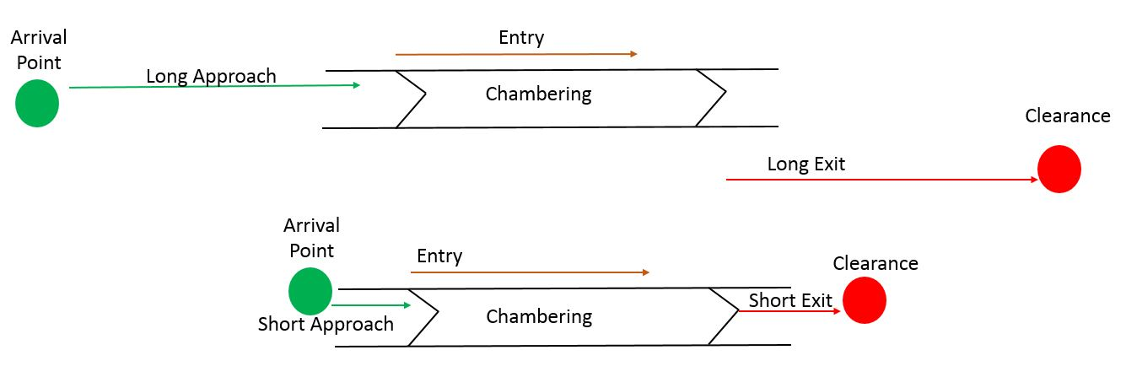
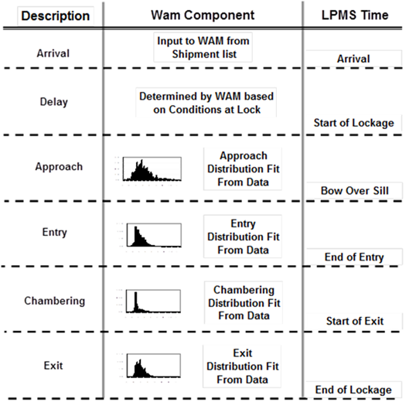
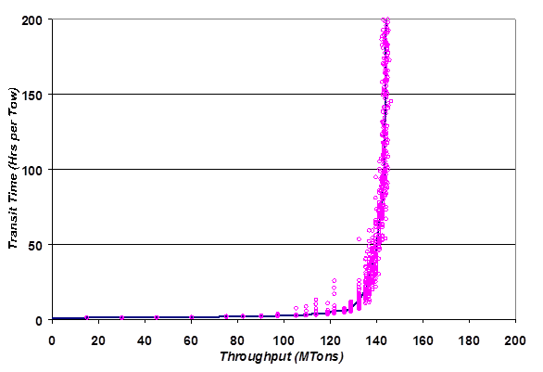
WAM Model Overview

Slide 4
Need for New Version
Model is very old
Core simulation logic written in SIMSCRIPT (proprietary simulation language from the early 70’s used for war-game simulations)
Input files are text files that simulate punch cards
As such, model set up and calibration can take months
One extra whitespace character in one of multitudinous input files can break simulation
Model support, upgrades difficult
Typically done under contract by Oak Ridge National Laboratory
Model is difficult to run, difficult to teach

Slide 5
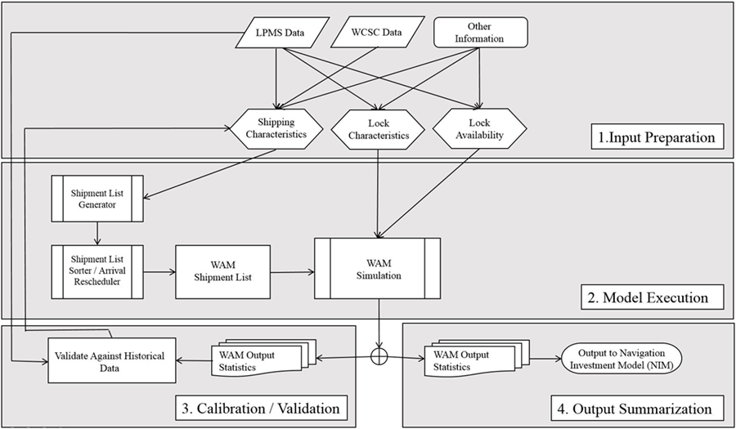
WAM2 Original Scope
Dynamically access pertinent input files from SQL databases, and automatically assemble input files
Minimal user manual input (or at least a lot less)
Foundation for future upgrades
Development into system simulation model, potentially equilibrium
Re-certification

Slide 6
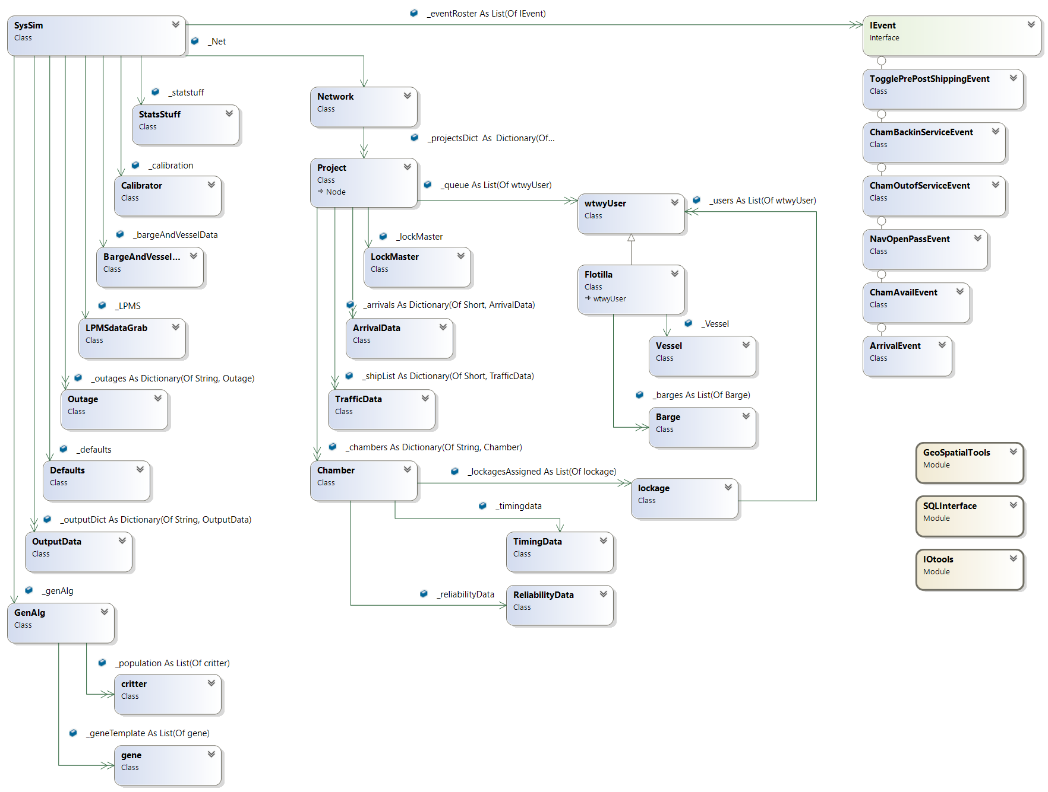

Slide 7
Development Process / Challenges
Figuring out what you want to do without first knowing what’s possible
‘Chimp with a tool’ approach – have an incrementally expanding toolset of ‘things that work’ but insufficient understanding of first-principles to know why
First large project, learned the hard way the importance of best practices I normally ignore (and still did to an extent)
Like commenting code ☹

